Slide 1

How To Engage Citizens (And Why)
Dan Munz
Center for New Media and Citizen Engagement
U.S. General Services Administration
May 27, 2010

Slide 2
Agenda
Introductions
What we did
Why we did it
What’s next
The challenge

Slide 3

Peter Levin, VA CTO

Slide 4
1.
Introductions

Slide 5
I’m Dan Munz
(@dan_munz)

Slide 6
I work at the
GSA Center for New Media and Citizen Engagement
(@GovNewMedia)

Slide 7
The Center strives to be an incubator and accelerator for government-wide new media and citizen engagement technologies, tools, practices, and policies.

Slide 8
Three missions:
Government → People
People → Government
Efficient & Effective
(Simple!)

Slide 9
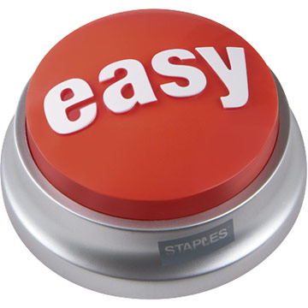
Even simpler

Slide 10
We’re Working On…
Ideation and Crowdsourcing
Contests and Challenges
Apps.gov EZ
Engagement Strategy
Accessibility and Usability
Legal and Policy
Terms of Service with New Media Providers
Building Community and Sharing Best Practices
Market Research
Connecting to the Vendor Community

Slide 11
2.
The challenge

Slide 12
The Open Government Directive

Slide 13
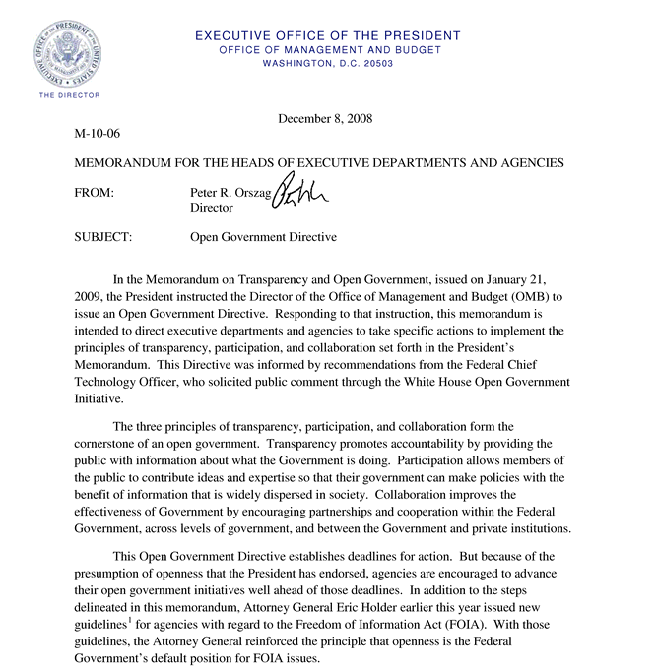
Create an Open Government Plan
Engage and get input from citizens on key questions
Do it really, really fast

Slide 14
OMB turned to GSA for a
government-wide
scalable
affordable
solution for agencies

Slide 15
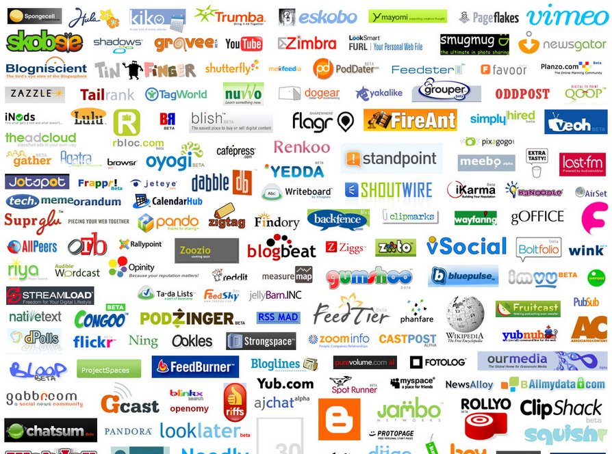

We chose to use
Low cost (civic pricing)
Quick startup (SaaS)
Government experience (Data.gov, FCC)

Slide 16
Timeline
OGD Drops
Engagement Begins
Engagement Closes
OG Plans Released
December 8
February 6
March 19
April 7
60 days
42 days
20 days

Slide 17

Perilous conditions!

Slide 18
3.
What we did

Slide 19

“We” =

Slide 20
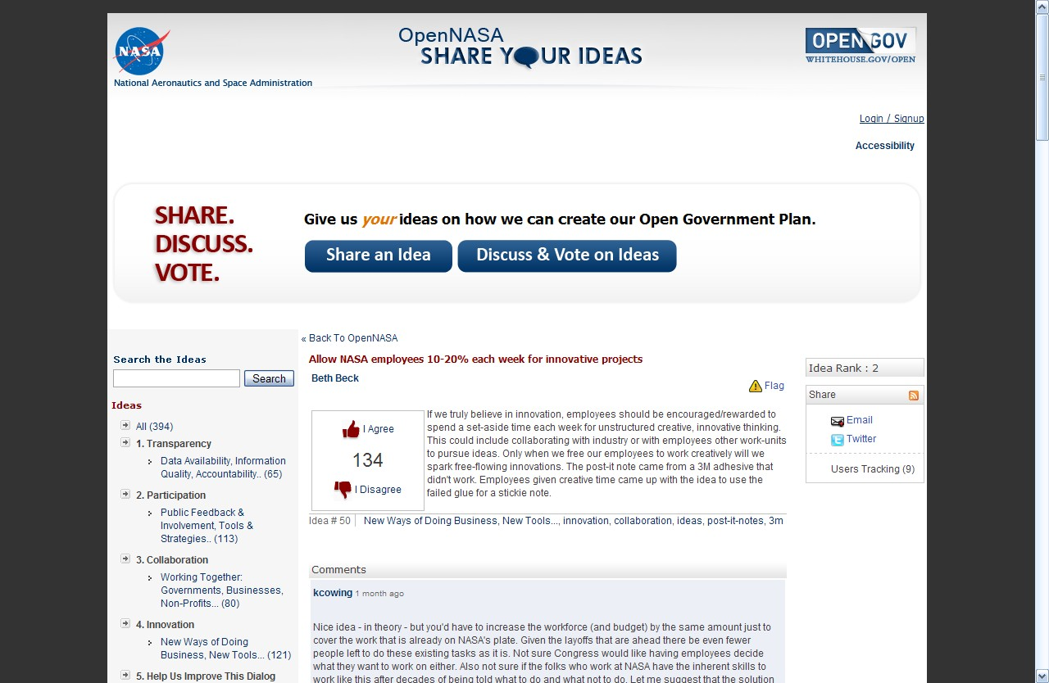
22 agencies + OSTP

Slide 21
We <3 Compliance
Privacy PIA and privacy statement
IT Security full due diligence
Paperwork Reduction Act clearance
Cookie Waiver for persistent cookies
Terms of Service that’s fed-friendly

Slide 22
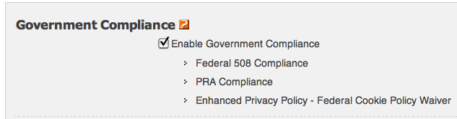
Bake in “better”
Accessibility and 508 Compliance
Usability Testing and Community Feedback
Cookie Use and PRA Policy

Slide 23

Build strong community
100+ trained
Moderation teams at each agency
130-member listserv
After-action review

Slide 24
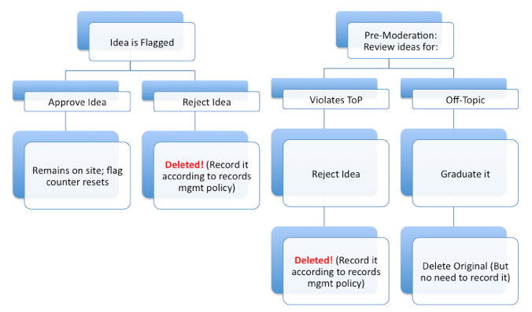
Share best practices

Slide 25
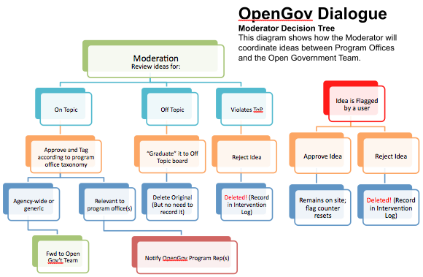
Create new ones

Slide 26
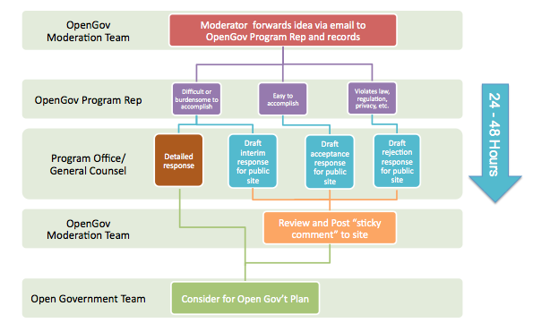
Create new ones

Slide 27
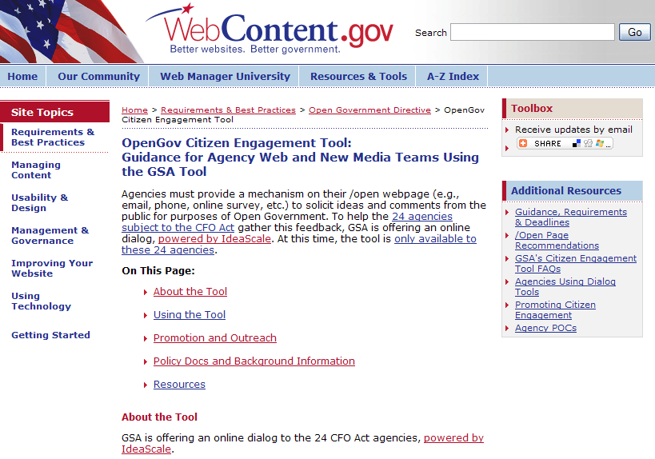
Show our work
Legal and policy resources
Training materials
Outreach tools
Usability testing results
Dialogue datasets

Slide 28
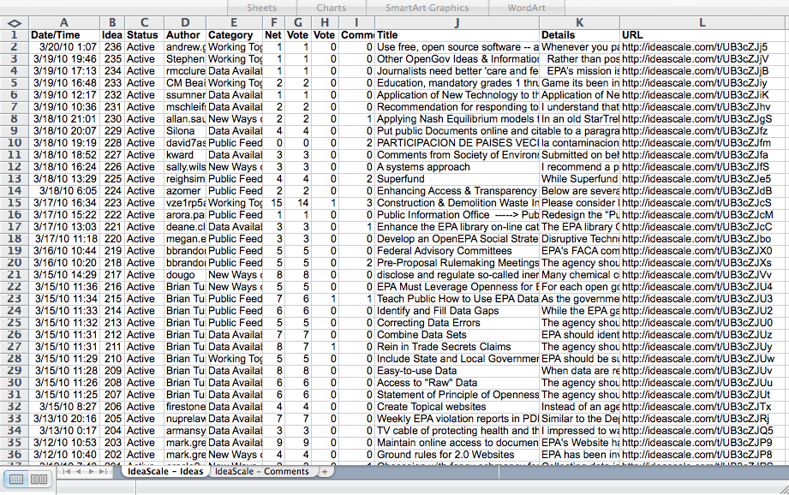
Engagement = high-value data

Slide 29
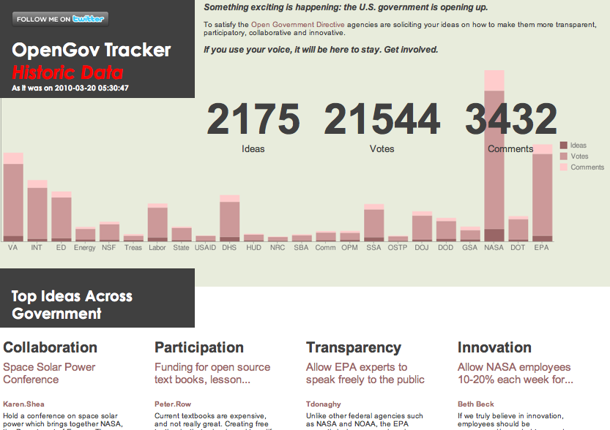
Data supports innovations

Slide 30
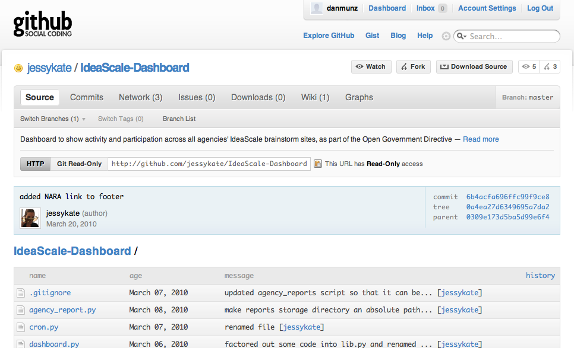
Innovation requires tools

Slide 31
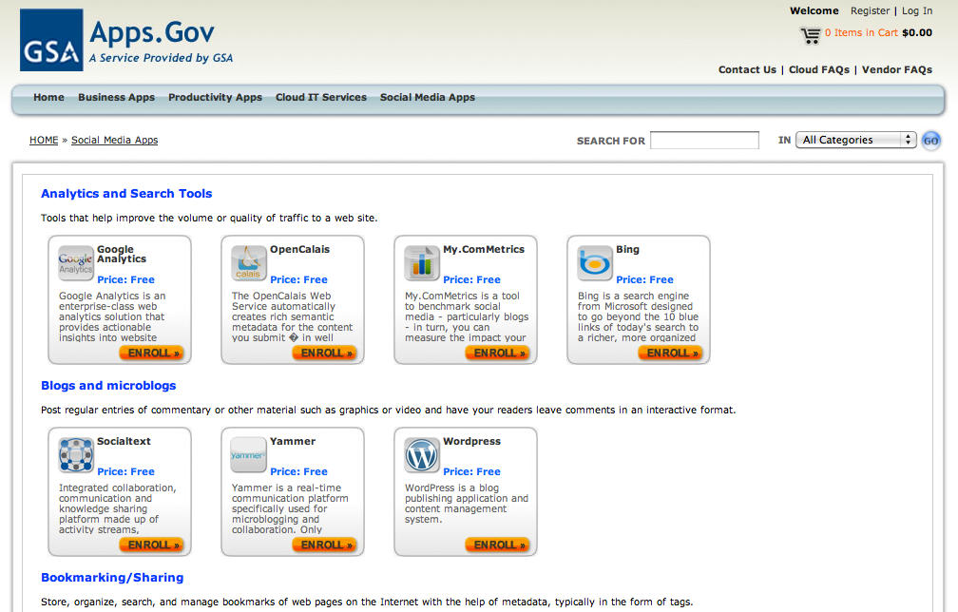
Hey, we’ve got tools!

Slide 32
Like I said before

Slide 33
4.
Why we did it

Slide 34
“The tool is the last thing you should think about!”
— Pretty much every social media expert ever

Slide 35
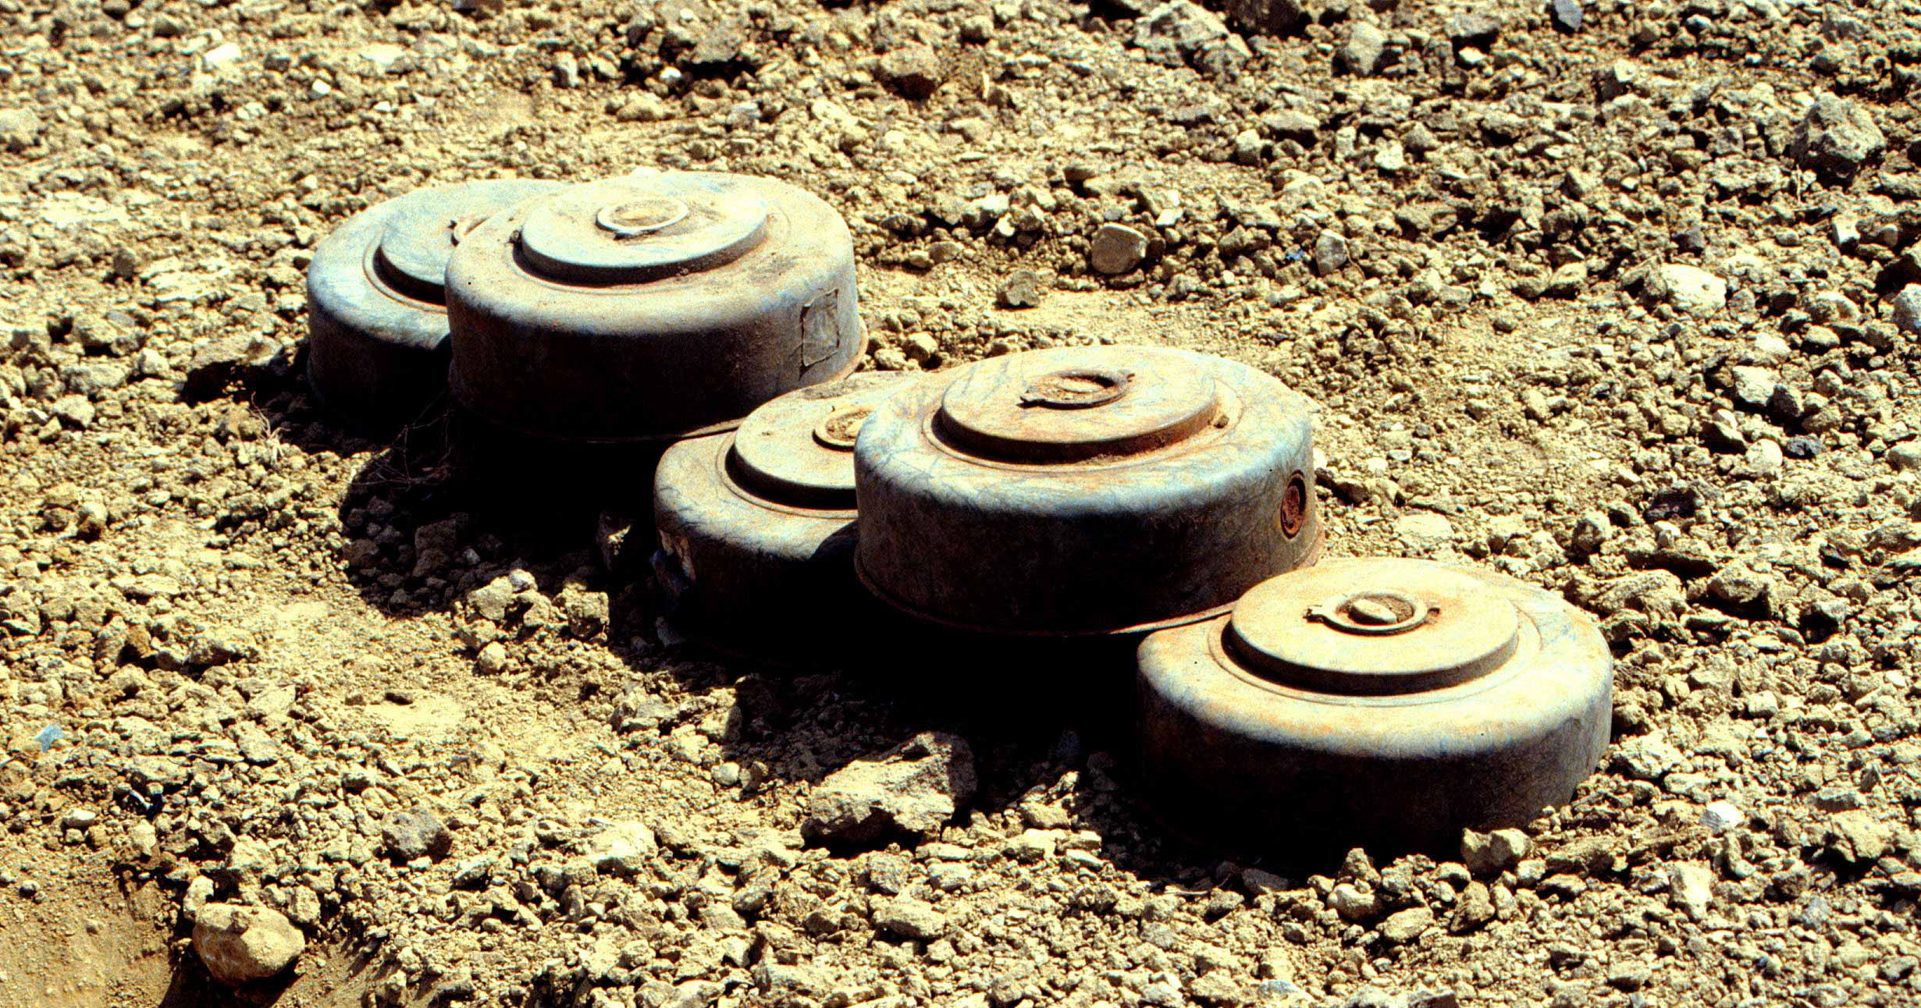
That’s where the landmines are.

Slide 36
A wicked trade-off
Work through challenges
Engage, learn, innovate
hosting security legal privacy records
training accessibility moderation metrics
(so many hours in a day)

Slide 37
So what?

Slide 38
Our argument:
Citizen engagement
is fun and exciting!
uses the Internet!
gets lots of great ideas!
makes government better.

Slide 39
How do we make that true?

Slide 40
The Virtuous Cycle
Agencies spend time learning, innovating and experimenting
Agencies build capacity and engagement is self-sustaining
Tools and resources are there to make engagement easy
Innovative ideas expose new demand and requirements

Slide 41

Until you become yourself, what benefit can you be to others?
– Harold Bloom

Slide 42
People deserve a government that’s good at listening to them.

Slide 43
5.
What’s next

Slide 44
Continued engagement
PCAST on increasing U.S. industrial capacity
DOT for comments on their FY2010-15 Strategic Plan
GSA to ask employees for ideas on environmental sustainability
Kids.gov to solicit ideas on a major site redesign
USAID to collect questions for a town hall with Administrator Shah

Slide 45
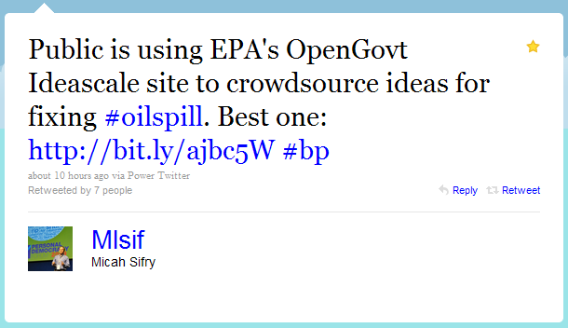
There when you need it

Slide 46
What’s on tap?
IdeaScale
Done
go.usa.gov
Blogs/Citizen Engagement Platform
Today
Gov-wide Challenge Platform
June
2010
FedSpace;
Challenge Options
July
2010
Fall
2010
What’s Next?
You
Decide!

Slide 47
Come help us build it!
We need:
Bright young Interns
Experienced savvy Detailees
Visionary creative Fellows
We have:
Government-wide perspective
Experimental “labs” environment
Access to tools, training, and smart people

Slide 48
Thank you!

